Slide 1
Artificial Intelligence
Bayesian Network

Slide 2
Bayesian Networks
Probability
Conditional Probability
Bayes Theorem
Bayesian Network

Slide 3
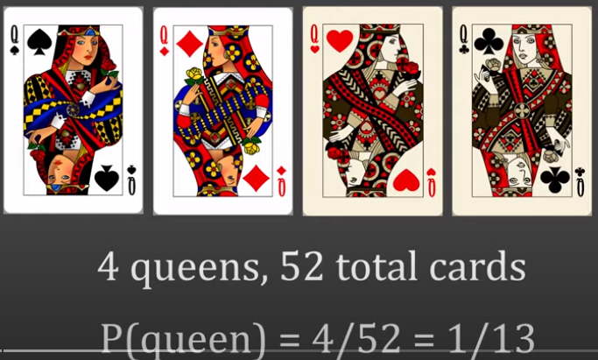

Probability
Probability is a measure of how likely an event is to occur, quantifying the uncertainty associated with the occurrence of that event.
It is expressed as a number between 0 and 1, where 0 indicates that the event will never happen, and 1 indicates that the event is certain to happen.

Slide 4


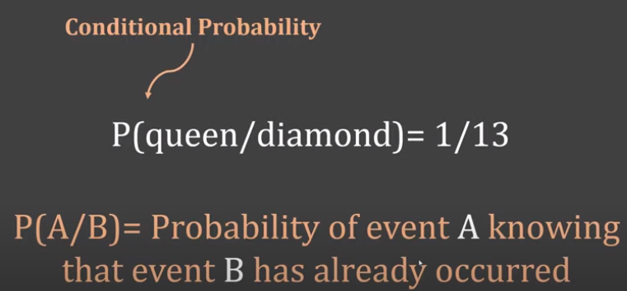
Conditional Probability
Conditional probability is the probability of an event occurring given that another event has already occurred.
It measures how the likelihood of one event changes when we have additional information about another related event.

Slide 5
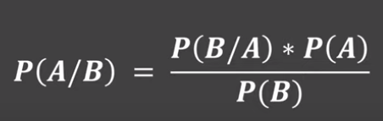
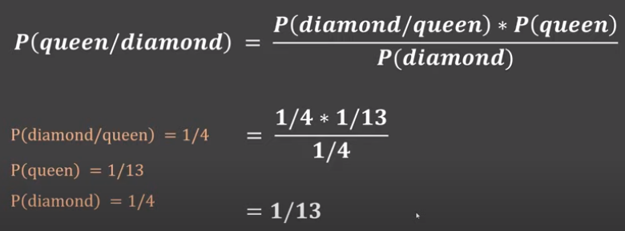

Slide 6
Bayes' Theorem (Bayes' Rule)
Bayes' Theorem (also often called Bayes' Rule or Bayes' Law) is a fundamental theorem in probability that describes how to update the probability of a hypothesis (A) when given new evidence (B).
It is a mathematical result derived from the definition of conditional probability.
The Formula:
P(A|B) = (P(B|A) * P(A)) / P(B)
Where
  A = hypothesis
  B = evidence

Slide 7
Bayes' Theorem (Bayes' Rule)
P(A|B) is the Posterior Probability: The probability of hypothesis A being true after observing the evidence B.
P(B|A) is the Likelihood: The probability of observing the evidence B if the hypothesis A is true.
P(A) is the Prior Probability: The initial probability of hypothesis A being true before observing B.
P(B) is the Evidence: The probability of observing the evidence B.
It is a mathematical equation used for calculating conditional probabilities, forming the theoretical basis for all Bayesian methods.

Slide 8
Example
Suppose we want to know:
  If we see clouds, what is the probability that it will rain?
  P(Rain | Cloudy)
We are given the following information:
  Prior Probability of Rain:
    P(Rain)=0.3(30%)
  Likelihood (Cloudy given Rain):
    P(Cloudy∣Rain)=0.8(80%)
  Overall probability of it being Cloudy:
    P(Cloudy)=0.5(50%)

Slide 9
Contd..
  P(Rain | Cloudy) = [P(Cloudy | Rain) × P(Rain)] / P(Cloudy)
Plug in the values:
  P(Rain | Cloudy) = (0.8 × 0.3) / 0.5
= 0.24 / 0.5
= 0.48
If the sky is cloudy, the probability it will rain is:
  P(Rain | Cloudy) = 0.48 (48%)

Slide 10
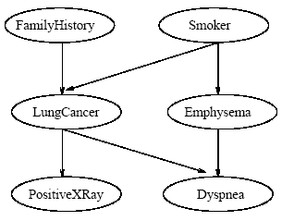
Bayesian Network
A Bayesian Network (also known as a Bayes Net or Belief Network) is a probabilistic graphical model that represents a set of variables and their conditional dependencies using a directed acyclic graph (DAG).
Nodes represent random variables (e.g., “Smoker," “LungCancer," “PositiveXRay").
Edges (arrows) represent direct probabilistic dependencies between the variables (e.g., an arrow from “Smoker" to “LungCancer" means the probability of LungCancer is directly conditioned on being Smoker).
It provides a structured way to model and perform probabilistic inference on complex systems by automatically applying Bayes' Theorem across multiple related variables.

Slide 11
Bayesian Network
A belief network is defined by two components
The first is a directed acyclic graph, where each node represents a random variable and each arc represents a probabilistic dependence.
If an arc is drawn from a node Y to a node Z, then Y is a parent of Z and Z is a descendent of Y.

Slide 12

Bayesian Network
The second component of a belief network consists of a conditional probability table for each variable
For a variable Z, it specifies the conditional probability distribution P(Z|Parents(Z))
The conditional probability for each value of Z is listed for each possible combination of values of its parents

Slide 13

Joint Distribution
The joint probability of any tuple (z1, …, zn) corresponding to the attributes Z1, …, Zn is computed by
Where the values P(zi|Parents(Zi)) correspond to the entries in the CPT for zi

Slide 14
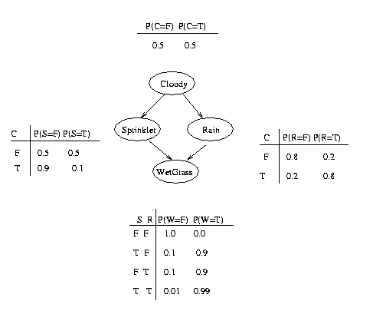
Example

Slide 15
Example:
Calculate the probability that the grass is Wet and it is not Raining and the Sprinkler is on and it is Cloudy.
= P(W, -R, S, C)
= P(W|S,-R)*P(-R|C)*P(S|C)*P(C)
= 0.9*0.2*0.1*0.5 = 0.009

Slide 16
Example
Calculate the probability that it is not cloudy, the sprinkler is on, it is raining, and the grass is wet.
= P(W, R, S, -C)
= P(W|S,R)*P(R|-C)*P(S|-C)*P(-C)
= 0.99*0.2*0.5*0.5 = 0.049

Slide 17
Example
Calculate the probability that it is cloudy, the sprinkler is not on, it is not raining, and the grass is not wet.

Slide 18
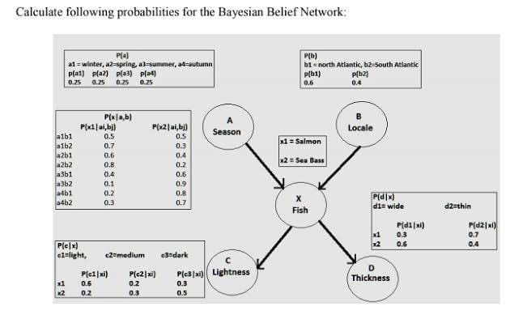
Example: Calculate the probability that a fish caught in summer, in the north Atlantic, is a sea bass, and is dark and thin:
P(a3, b1, x2, c3, d2)
= P(a3)P(b1)P(x2|a3,b1)P(c3|x2)P(d2|x2)
= 0.25 x 0.6 x 0.6 x 0.5 x 0.4 = 0.012

Slide 19
Naive Bayes

Slide 20

Naïve Bayes Algorithm
The Naive Bayes algorithm is a probabilistic machine learning classifier based on Bayes’ theorem.
It’s called “naive” because it assumes that all features are independent of each other.
Which can be expressed as:
Now, as the denominator remains constant for a given input, we can remove that term.
Now, we need to create a classifier model. For this, we find the probability of given set of inputs for all possible values of the class variable y and pick up the output with maximum probability. This can be expressed mathematically as:
Note that P(y) is also called class probability and P(x_{i} | y) is called conditional probability.

Slide 21
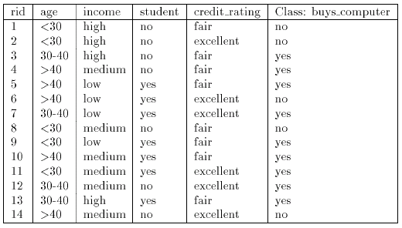
Example

Slide 22
Example
Let C₁ = class buy computer and C₂ = class not buy computer
The unknown sample:
X = {age ≤ 30, income = medium, student = yes, credit-rating = fair}
The prior probability of each class can be computed as
P(buy computer = yes) = 9/14 = 0.643
P(buy_computer = no) = 5/14 = 0.357

Slide 23
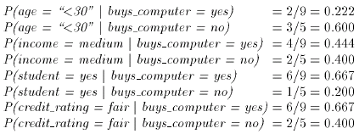
Example
Example:
To compute P(X|Ci) we compute the following conditional probabilities

Slide 24
Example
Using the above probabilities we obtain
And hence the naïve Bayesian classifier predicts that the student will buy computer, because

Slide 25
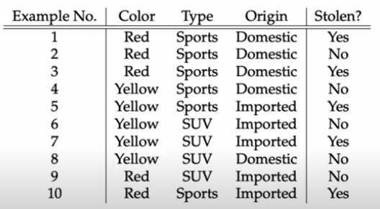

Slide 26
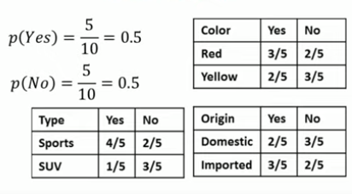
Calculate Prior and Conditional Probabilities

Slide 27
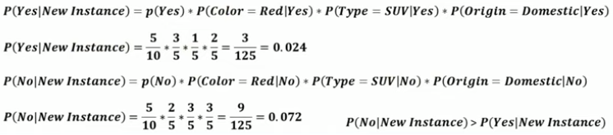

Slide 28
Bayesian Network vs Naïve Bayes Model
Aspect | Full Bayesian Network (Joint Distribution) | Naive Bayes Model (Joint Distribution)
Variable Dependencies | Models dependencies explicitly: • Fish (X) depends on Season (A) and Locale (B) • Lightness (C) and Thickness (D) depend on Fish (X) | Assumes conditional independence of features given the class (Fish X). Lightness (C) and Thickness (D) are independent given X.
Joint Probability Computation | Factorizes according to network: [ P(A,B,X,C,D) = P(A) \cdot P(B) \cdot P(X \mid A,B) \cdot P(C \mid X) \cdot P(D \mid X) ] | Simplifies using Naive Bayes: [ P(A,B,X,C,D) \approx P(A) \cdot P(B) \cdot P(X \mid A,B) \cdot P(C \mid X) \cdot P(D \mid X) ] (Here X is treated as the class; A and B may be treated as features depending on implementation.)
Accuracy of Joint Estimates | High, preserves dependencies among Season, Locale, and Fish; interactions are captured. | May be less accurate if strong dependencies exist; assumes features are independent given X.
Computational Complexity | Higher, full factorization and marginalization may be needed for inference. | Lower, only multiplies conditional probabilities; scalable for many features.
Interpretation | Provides detailed insight into causal/conditional relationships: e.g., how Season and Locale influence Fish, which influences Lightness/Thickness. | Easier to implement; fast estimation but may miss correlations between variables like Season ↔ Locale affecting Fish.
Example in Context | Can compute exact probability of a fish being Salmon or Sea Bass in Spring from North Atlantic, and the probability of light/thin fish jointly. | Quickly estimates probability of fish type given features assuming independence; may slightly misrepresent joint outcomes.

Slide 29
References
Chapter 12, 13, Artificial Intelligence, A Modern Approach, Forth Edition, Stuart Russell and Peter Norvig

